Slide 1

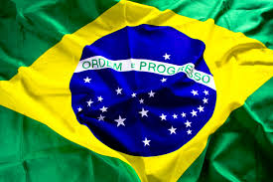

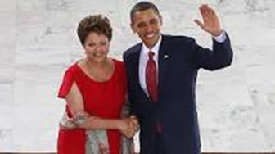

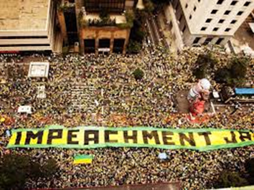
Brazil Rising:
Opportunities and Challenges

Slide 2
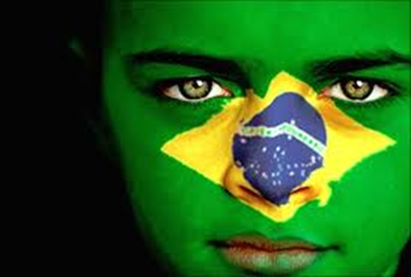
Presentation
Perceptions
Singular Geography
Short History
Culture / Race
Brazil – US Relations / Comparative Analysis
Current Economic & Political Crisis

Slide 3










Academic / Professional Experience

Slide 4
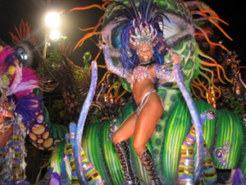
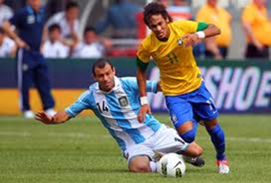
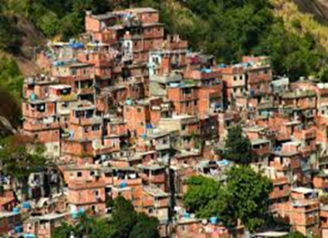
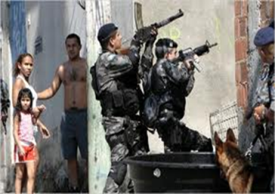
Perceptions
Most exciting nation in the world (Financial Times)
Friendly and welcoming country (common view)
Awakening Giant / Country of the Future
Brazil is not for beginners (Tom Jobim)
Brazil is not a serious country (Charles DeGaulle)
Paradoxes and misperceptions
  racial democracy vs. historic racism
  peaceful country vs. violent society
  bountiful country vs. chronic poverty
  friendly people vs. cynical citizens

Slide 5
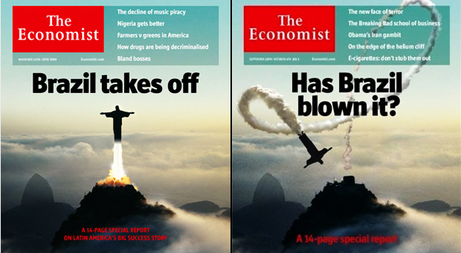
Brazil Rising?
Current Economic and Political Crisis
2009
2013

Slide 6
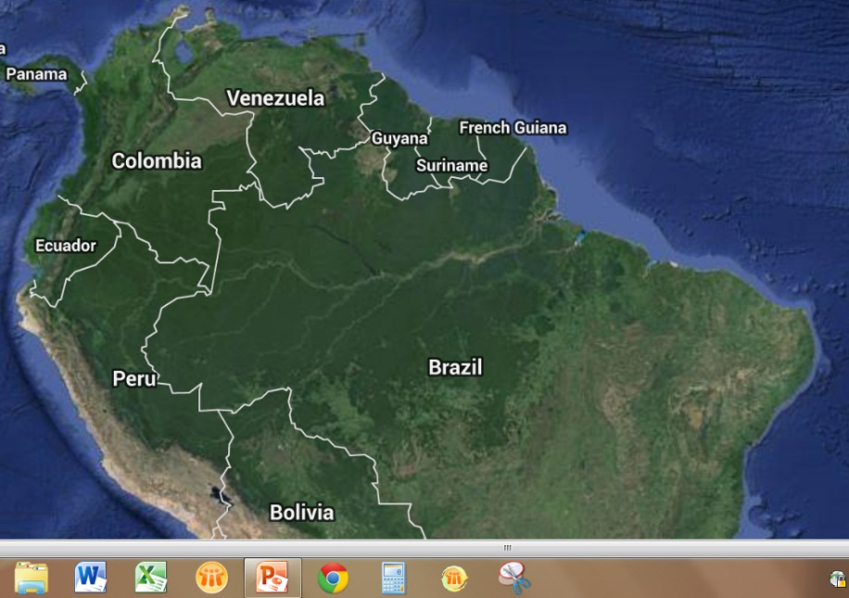
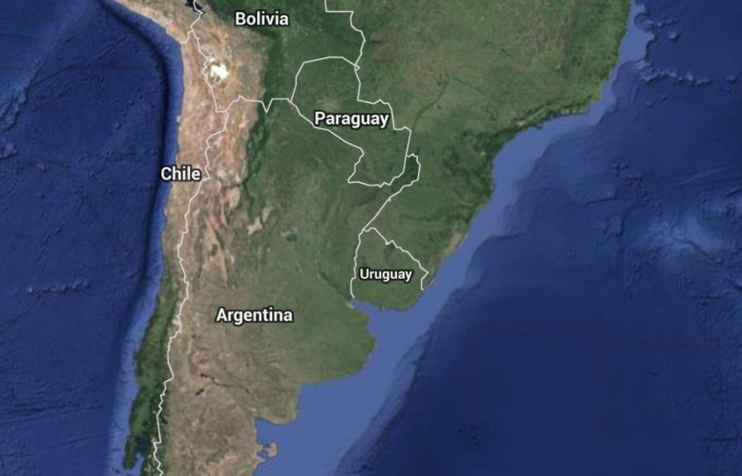
Singular Geography
Half of South America
Borders 10 of 12 countries
7,491 km coast line (16th largest)
Decentralized colonial governance led to unified country (unlike Spanish colonies).
Hugging the Coast (Western expansion took 2 centuries)

Slide 7
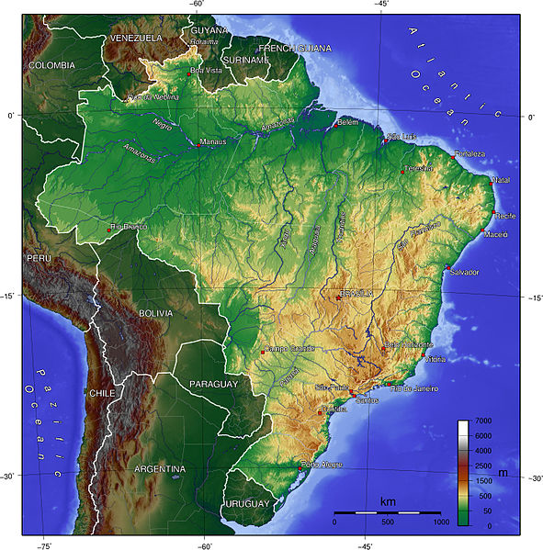
Topography / Water Resources
Massive rivers (run West to East making westward expansion difficult)
Major Ecosystems
  Amazon (1/3 of world’s rainforests)
  Sertão (10% of country)
  Mata Atlântica
  Pantanal (one of world’s largest wetlands)
  South (temperate)

Slide 8
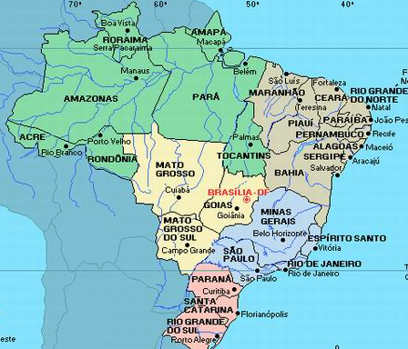
Regions
5 distinct regions
27 states
Historic Economic Cycles
Immigration impacts
Regional disparities
Brasilia gamble (1960)

Slide 9
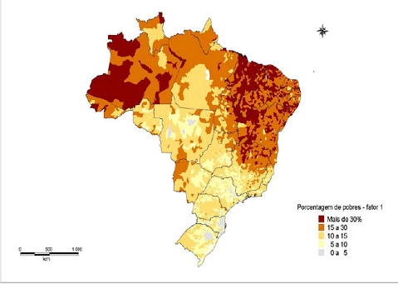
Mapping Poverty

Slide 10
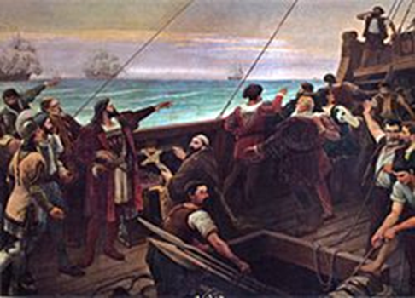
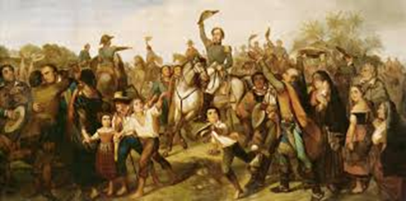
Historic Trends
Negative impacts of colonial legacy Portuguese mercantilist model, brutal slavery, rural oligarchies experience)
Central control vs. decentralization
Reoccurring conflict throughout history, yet
more successful than Spanish colonies
Polarized politics:
conservatives vs. liberals (19th century)
urban vs. rural
right vs. left (20th)

Slide 11
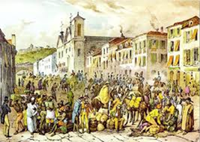
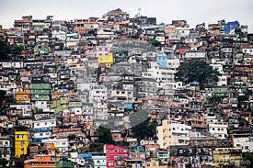
Historic Trends (cont)
)
False transitions (independence, abolition of slavery, military republic, democratization)
Continental size yet insular outlook
Huge country with small country mentality
Uneven Development
Boom and bust economy, unequal regional
development, unplanned urban growth

Slide 12
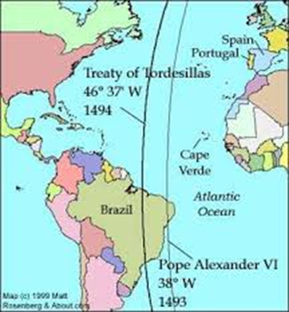
Colonial Legacy
Treaty of Tordesillas
  Pope Alexander VI (1494)
  Intended to give ‘new world’ to Spain
  and Africa and India to Portugal
Portuguese Explorers
  Naturally inclined towards ocean exploration
  Camōes wrote “As Luziadas”
  Built Caravels and excelled in map making
  / sailing
Foreign Encroachments
  Spanish (Sao Paulo -- 1520s )
  (Santa Catarina – 1540s)
  French (Rio de Janeiro – 1555 - 1567)
    (Maranhao – 1615)
  Dutch (Salvador – 1624 – 1625)
  (Pernambuco – 1630 - 1654)

Slide 13

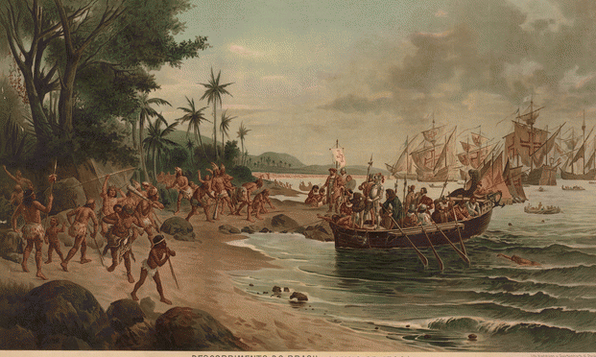
Portuguese Arrival
Pedro Alvares Cabral
  13 ships / 1,200 crew members
  Sailing to India
    forced off course on way to India
Arrived in Porto Seguro, Bahia
  22 April 1500
  Received by local indigenous peoples
Pedro Vaz de Caminha
  wrote back about fertile and idyllic tropical paradise
  strategy to encourage future expeditions
  contrast with bleak living conditions in Portugal

Slide 14
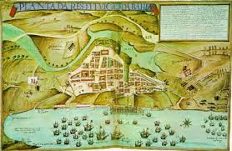
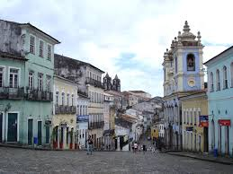
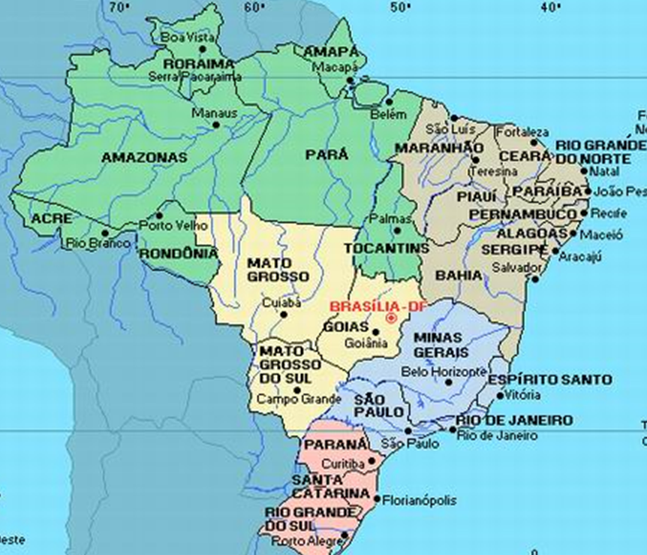
Southward Expansion
Northeast was initial center of colony with predominance of sugar cane produced in large plantations.
  Salvador established as capital in 1552
  and served as main port to ship out the
  processed sugar to Europe.
When gold was discovered in Minas Gerais in 1690s, there was a southward expansion.
  Capital of Brazil moved to Rio de Janeiro
  in 1763 and it became the largest port to
  ship the gold to Portugal.
With the emergence and dominance of coffee
in 1830s expansion continued southward to
Sāo Paulo.

Slide 15
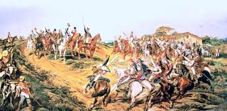
Independence
    When Portuguese tried to force D. Pedro I
    to return to Portugal, he declared
    Independence on 7 September 1822
    Grito do Ipiranga: “independencia ou morte”.
    Unprecedented that independence was granted
    by royal member who governed Brazil for the
    next 60 years (false transition).
      The first and only monarchy in the colonized world.
      No break with established political order dominated by the Portuguese
      Landholding elites maintained their power.

Slide 16
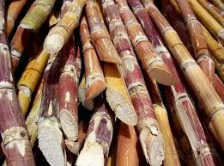
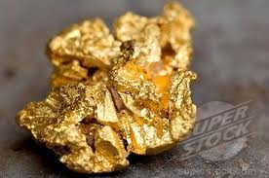
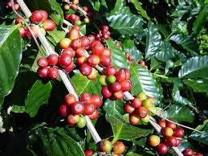
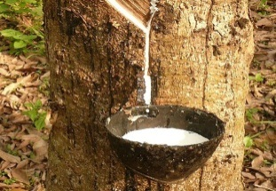
Boom and Busts Economic Cycles
  Paul Brazil (1500 - 1530)
    Used as crimson clothing dye
  Sugar Cane (1530 – 1650)
    Primarily in Northeast
    World’s largest exporter / 90% of Brazil’s exports
    Northeast Brazil richer than New England / Virginia
    Lost market share to more productive Caribbean
  Gold (1690s – 1770s)
    Gold rush in Minas Gerais, Mato Grosso, Goiás
    Largest gold producer in world
    Included diamonds by 1720s
  Coffee (1830 - 1930)
    Became largest producer in the world
    Led Sāo Paulo and Minas Gerais to economic dominance
  Rubber (1880 - 1920)
    Natural rubber in Amazon (rubbertappers)
    Demand grew in response to automobile industry
    Replaced by industrial rubber in Malaysia

Slide 17
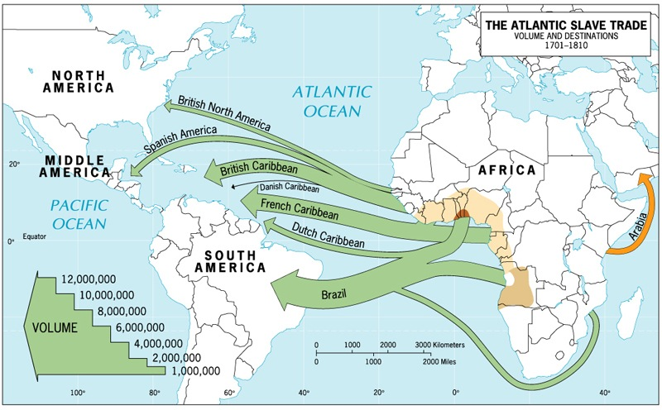
Slavery

Slide 18
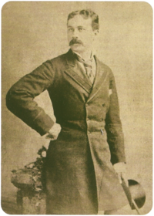
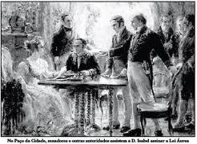
Slavery - Abolition
Slavery lasted longer in Brazil than any other country.
  350 years (1538 – 1888)
Small abolition movement
  Led by Joaquim Nabuco who established Anti-slavery Society.
  More concerned about the ‘Africanization’ of Brazil
  than moral arguments
  First Brazilian Ambassador to US
Slavery repealed through gradual laws
  Slave Trade illegal (1850)
  Law of Free Womb (1871) – children of slaves free
  after 21years
  Sexagenarian Law (1885) – slaves over 60 freed
  Finally abolished by Lei Aurea signed by
  Princesa Isabel (May 13, 1888)

Slide 19
BRAZIL – UNITED STATES
Similarities / Differences
Notes:
One researcher identified 47 different terms to describe this sector worldwide.

Slide 20
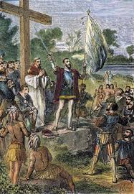
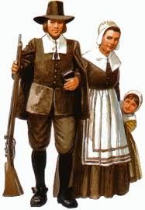
Contrasting Colonization Models
Both countries colonized by European powers
  “discovered” at approximately same time (Columbus arrived1492 / Cabral in 1500)
  Both countries gained independence, although through different paths
    US through bloody American War of Independence (1776)
    Brazil through bloodless D. Pedro I declaration (1822)
Colonization experience completely different
  Portuguese approach (similar to Spanish) one of “resources exploitation” and little emphasis on developing local governance
  British pilgrims came to find “new world”, to establish freedom of religion and abolish church-state monopoly which characterized Europe
Different demographic colonization patterns
  While Portuguese largely brought only men / the British brought entire families
    Paradoxically, this led to miscegenation or inter-racial mixing and softening of color lines
    This had long-lasting impact on nature of slavery and race relations in Brazil today

Slide 21
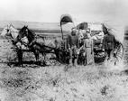
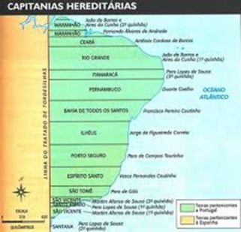
Inverse Land Occupation Patterns
  In US, British colonists began land distribution from outset.
    First in the East Coast in 1500 - 1600s with pilgrims, and then through western expansion in 1800s with the Homestead
    Act of 1862.
    This led to small landholding pattern in many parts of the country (similar to Southern Brazil).
  Portuguese set up huge estates (capitanias heriditárias) in 1500s.
    This led to landed elite which has dominated Brazil for 500 years until today.
      Rural, conservative vote still dominates Northeast, Centerwest and Northern regions of country and Brazilian Congress.
    Large landholding patter (similar to Southern United States).
      Non-regulated land and corruption in North and Centerwest has led to confusing titling and rural violence. (Chico Mendes (Acre), Sister Dorothy Stang (Pará).

Slide 22
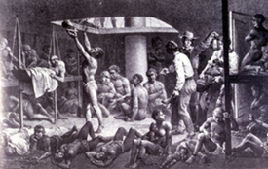
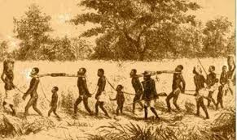
Differing Approaches To Slavery
Slavery was equally brutal and dehumanizing in both countries but had key differences.
Brazil brought 10 times more slaves and
(due to distance and cost)
Despite claims by Gilberto Freire, Brazil
implemented more brutal model.
      average life span of slaves in Brazil was only 20 years worked to death easily replaced by new ones.
      average slave in Brazil only lived 3 years after arrival in country.
Brazilian slave owners discouraged procreation
among slaves and fought family cohesion.
Slaves in US were acculturated more quickly into
white culture and religion.
  Key role of religion in US African-American communities.

Slide 23
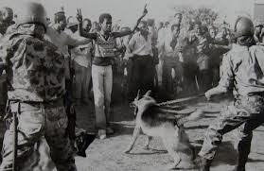
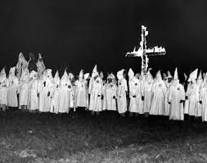

Similar / Distinct Racism Legacy
Brazilian racism different from US or South Africa.
  Discrimination determined not by blood by but appearance and class.
  Overt discrimination or segregation laws never enacted in Brazil like in US and South Africa.
Brutality of slavery and four centuries of class discrimination.
  Has led government to not invest in education and health care for the majority of Afro-descendants until recently, leaving the majority of poor disenfranchised.
Even today and despite the 1988 constitution which promulgated universal equality.
  Afro-descendants do not feel the full benefit of citizenship and the fair application of the rule of law.

Slide 24
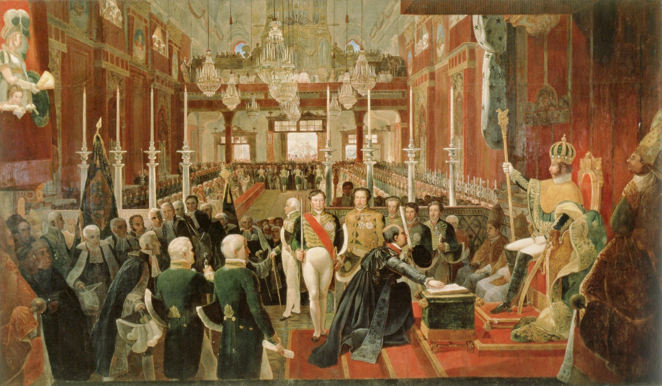
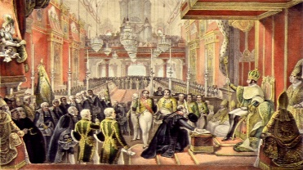
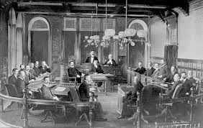
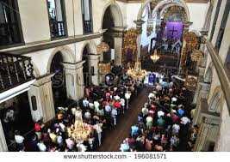
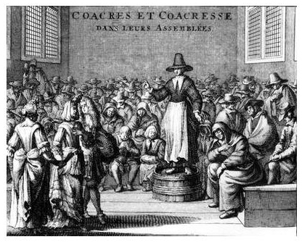
Governance / Religion
Distinct Governance Models
  Portuguese colony imposed centralized & hierarchical governance structure.
    Lack of ‘real transitions’ kept unequal rural structures intact and did not encourage industrialization.
  British allowed for more community-based governance
    Independence and civil war led to social reforms and industrialization.
Different Religious Experiences
  Catholic church in Brazil was hierarchical, supported traditional values, unequal class structure, and slavery.
  Protestant churches in US was decentralized, promoted social reforms, emphasized entrepreneurship, and fueled abolition movement.

Slide 25
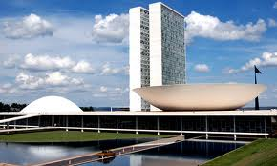
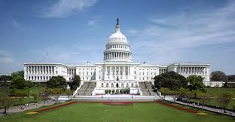
Similar/Contrasting Political Systems
Identical but distinct government systems.
  Presidential forms of government.
  Separation of powers.
    Executive / Legislative / Judiciary.
On other hand, Brazil’s electronic election technology being copied by
some US states.
The sense, however, is that Brazil copied the US’s political hardware
(structure and institutions) but not its software (democratic
governance)
Opposite origins: from bottom-up vs. top down
  UNITED STATES: federal government established by independent colonies.
  BRAZIL: the federal government created the states through elite patronage.

Slide 26
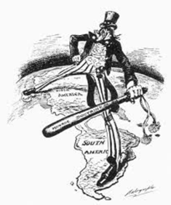
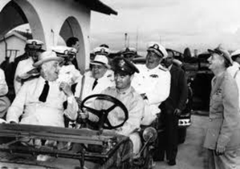

Close Historic Relations
American independence movement influenced Tiradentes and Brazilian independence movement.
Mutual support during the 19th Century.
  In 1823 Brazil declared public support for the Monroe Doctrine
  which was intended to reduce European influence in the Americas.
  In 1824 the US was the first country to recognize Brazil’s declaration of independence from Portugal.
  In 1889 was the first country to recognize Brazil’s First Republic.
Close collaboration during World War II.
  Brazil only South American country to send troops to Europe.
  US air force allowed to use bases in Rio Grande do Norte
  for African campaign.
There has also been close collaboration on social policies at times.
  Fome Zero program being based on the US. Food stamp Program.

Slide 27
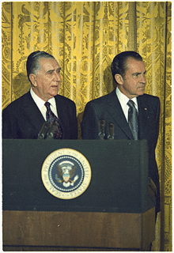
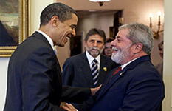
Recent Diplomatic Relations
  Military Regime
    Brazilian military followed US anti-communist cold war policies.
    US supported 1964 military coup.
    Only tension was during Carter Administration around human rights issues and nuclear accord with Germany.
  Presidential visits
    17 Brazilian presidents have visited the US.
      The first was D. Pedro II who travelled to US in 1870s to meet with Ulysses Grant.
      Lula visited 3 times.
    14 US presidents have visited Brazil.
      George W Bush visited twice and Obama once.

Slide 28


Recent Diplomatic Relations (cont.)
Cardoso was naturally friendly to the US having taught at
several US universities during exile.
Lula was surprisingly pragmatic with US despite historic
anti-US stance and strong third world rhetoric.
  Surprisingly warm relations with Bush
  (both ‘gut’ politicians).
Dilma’s relations with Obama began well but soured
  by embarrassing revelations from ‘wikileaks’.
  When reading the many US Embassy cables leaked I felt
  they showed progressive and knowledgeable analysis
  by US diplomats.
Dilma had successful visit to Washington in 2015,
but was overtaken by political crisis.

Slide 29



Strong Economic Ties
  US is second largest importer of Brazilian products
  overall (China is first).
      US is largest buyer of Brazilian manufacturing products.
  US is also second largest exporter to Brazil.
  Largest source of Direct Foreign Investment (FDI) into Brazil
    Brazil serves as headquarters for most of US firms doing business in
    Latin America.
    American companies (automobiles, banking, food processing,
    agriculture, manufacturing) have heavy presence in Brazil.
Brazilian firms beginning to invest in US (JBS-Friboi, Ambev)
  Strong Brazil – US cooperation on alternative fuels (ethanol)
  and aircraft technology.
  Brazil has growing number of large global companies:
  Petrobras (27th), Banco Itau (42%), Banco Bradesco (45%),
  or 31 or the world’s 2000 top companies.

Slide 30

Challenges Going Forward
While Brazil and US always claim that they have a common heritage and similar geopolitical interest, neither country seems willing to take relationship to next level.
  They often compete for influence in Latin America
  and Brazil does not vote with US at the UN.
Trade differences over agricultural tariffs (e.g. cotton,
orange juice) continue to keep relations cool in this area.
  Haven’t signed a major trade agreement in over 20 years.
  Brazil hesitant to open its economy to the US as it fears losing market share.
Yet Brazil and US have common interests in many areas.
  climate change, transnational drug trade, nuclear proliferation.

Slide 31



Economic Downturn
Country Entered Recession
  Economy entered recession and GDP contracted 1.7% in third quarter of 2015.
  Inflation increased steadily and stabilized at 9% — the highest rate since February 2003.
  Standard & Poor’s downgraded Brazil’s credit rating to ‘junk’ grade in September 2015.
  Like most developing economies, the Brazilian stock market has also performed poorly, with the Bovespa index trending lower in the past three years.
  Brazilian Real plummeted reaching its lowest value against the US dollar since 2002 (US $1.00 = R$4,00).

Slide 32



Causes Of Economic Crisis
Large debate about whether the global financial crisis
or irresponsible fiscal policies led to crisis.
  Appointment of Joaquin Levy (orthodox economist) after reelection was acknowledgement by Dilma that she needed to turn to more traditional economic policies of fiscal adjustment, raising taxes, and deficit reduction.
  Levy, however, only lasted one year due to political pressure and was
  fired and rewarded with Managing Director position at the World Bank.
  He was replaced by Nelson Barbosa who is a left-leaning economist and
  closer to Dilma.
Masking the Crisis
  Dilma put off the effects of the 2008 global economic crisis until after her November 2014 reelection.
  Growing deficit was hidden through pedaladas fiscais or creative accounting by borrowing illegally from state banks.
  Government Increased spending on social programs and infrastructure before elections.

Slide 33



Lava Jato Corruption Case
Petrolāo was launched by the Federal Police in March 2014
  Coined Lava Jato due to the use of the Posto da Torre (Gas Station) in Brasilia to launder bribes from Petrobras.
  It was discovered by chance when doleiro (black market dealer) Alberto Youssef bought a Land Rover Evoque for Paulo Roberto Costa, ex-director of Petrobras.
  It exposed a scheme designed to embezzle assets from Petrobras, which could be as high of $10 billion dollars.
  Considered the most serious corruption scandal in Brazilian history.
  Led by young prosecutor Sergio Moro from Paraná.
  Two key prosecutorial instrument were introduced which allowed the investigations to prosper:
    delaçāo premiada or plea bargaining;
    jailing convicted persons after first appeal stage.

Slide 34



Going After the Corruptors
For the first time in history a corruption investigation has gone after the ‘corruptors’ and not just the ‘corruptees’
  Directly involved nine major Brazilian construction firms: Camargo Correa, OAS, UTC, Odebrecht, Mendes Junior, Engevix, Queiroz Galvao, Iesa and Galvao Engenharia.
    Brazil’s Government is Falling Apart…and its Good News? (10:17)
    https://www.youtube.com/watch?v=rFKsY5O7oYs
More than 50 persons have been arrested including Petrobras managers, leading politicians and business leaders. These include:
  Renan Calheiros (Head of Senate), Eduardo Costa (Head of House of Representatives), Edson Lobāo (ex-Minster), Joāo Vaccari Neto (PT Tresurer), and Fernando Oderbrecht (head of Oderbrecht).

Slide 35



Dilma’s Impeachment
Impact on President Dilma
  While accusations haven’t reached Dilma (despite the fact that she chaired the board of Petrobras from 2003 to 2010 and was involved in appointing its managers and overseeing decisions), the political impact of the crisis has.
  There have been several large street demonstrations and panelaços throughout the country, and her approval rating reached only 9%.
Impeachment Proceedings
  After six months of street demonstrations (unprecedented 3 million went to the streets in over 250 cities completely overshadowing pro- Dilma demonstrations) and impassioned debated.
  Dilma was impeachment in August 31 by a vote of 61-to-20 in the Senate (But Jeitinho Brasileiro used to allow her tokeep political rights).

Slide 36



Ex-President Lula Jailed
Now they are going after Lula himself through the Operaçāo Zelotes
  Due to an apparently unearned $2 million contract given to one of his sons and millions given to Instituto Lula.
  Use of two properties (beach front apartment and rural weekend house) which were renovated by several large construction (spending nearly a $1 million dollars) companies with Petrobras contracts.
  Seems to have crossed the line between ‘political vs. personal’ corruption
  Lula jailed in April 2018
Positive Aspect
  The unprecedented and hard hitting investigation is the silver lining
  of this crisis as it has empowered the judicial branch and is
  improving the country’s image long-term.
  This process will hopefully strengthen Brazilian democracy.

Slide 37




Temer Government / 2018 Elections
  Temer was Dilma’s Vice President and leader of PMDB.
    Well-known and skilled politician who has been Speaker of the House twice.
    Brought country out of economic crisis, but economic recovery has been slow.
    Promised to undertake needed labor, fiscal, political, and pension reforms, but only accomplished labor and fiscal reforms.
    Has approval rating of around 4% (among lowest in history)
  Has been indicted twice for corruption charges, but Congress voted to prevent Supreme Court to investigate.
    Will most certainly be prosecuted once he leaves office in January 2019.
  Presidential elections in October 2018 has wide open field.
    With Lula in jail, left in weakened position
    First time in 30 years, far right has strong candidate (Bolsonaro)
    Danger of ‘populist’ leader being elected

